Slide 1
Gear Design
ME 313: Mechanical Design
Week 9

Slide 2
What are Gears?
Rotating machines with cut teeth or cogs to transmit torque

Slide 3
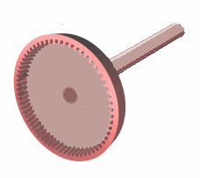
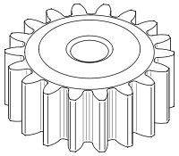
Type of Gears
Internal vs External Gears
While most gears we use are usually external gears, there are still some uses for internal gears

Slide 4
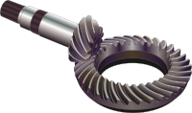
Type of Gears
Spur gears
Bevel gears

Slide 5
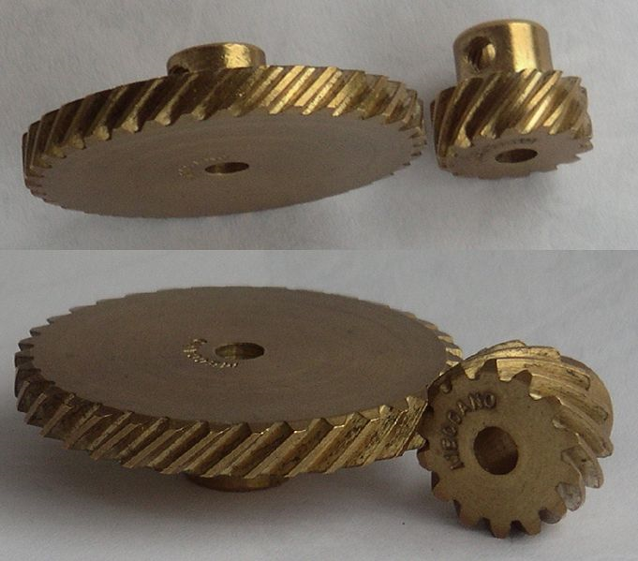
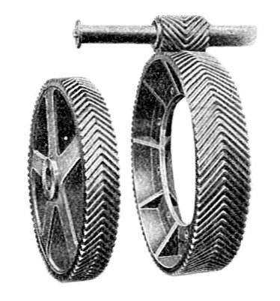
Type of Gears (cont)
Helical gears
Double helical gears

Slide 6
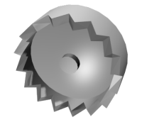
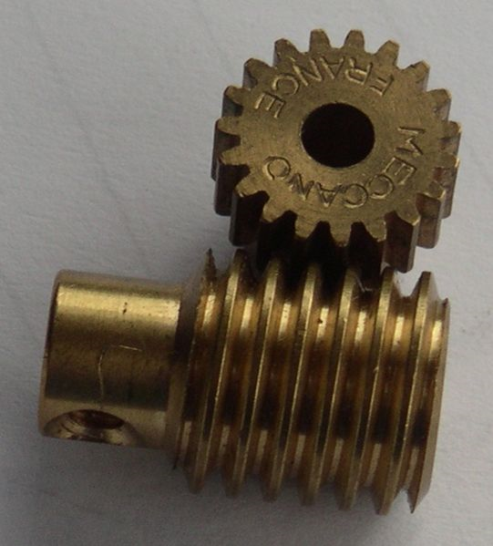
Type of Gears (cont)
Crown Gears
Worm Gear

Slide 7
Types of Gears
Rack and Pinion
Planetary Gear

Slide 8
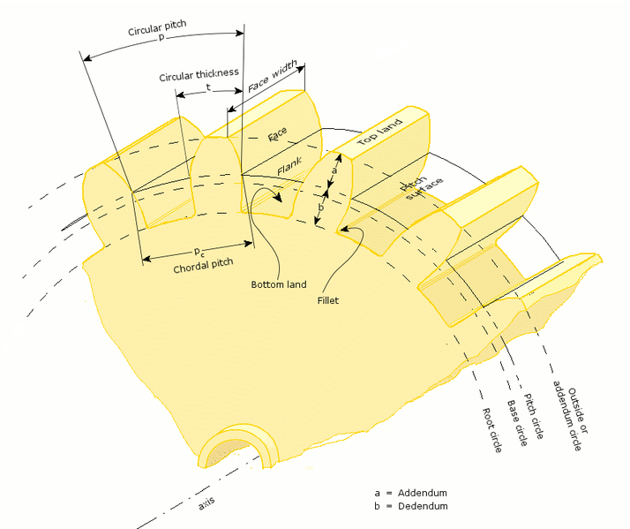
Gear Geometry

Slide 9
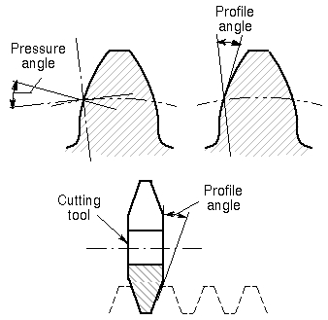
Pressure Angle
Angle of gear surface compared to pitch circle tangent line
Typical values are 20 and 25 degrees

Slide 10
Mating Two Gears
Two mating gears must have the same circular pitches
They also must have the same pressure angles

Slide 11
Fundamentals of Gear Motion
Gear angular velocity ratio is dependent on gear pitch radius ratio

Slide 12
Force Transmission
Force transmitted in gear is dependent on the pressure angle, φ
where F is the total reaction force

Slide 13
Torque Transmission
Only the tangential force transmit torque and power
If pitch line velocity is v, then power, P, is

Slide 14
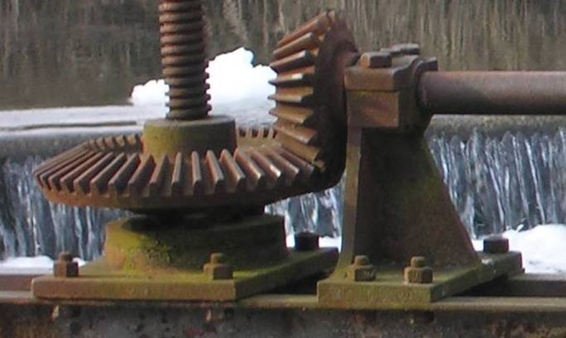
Bevel Gear
Aside from pressure angle φ, bevel gear is also defined by angle of pitch surface, γ

Slide 15
Force Analysis—Bevel Gears
Assume that the forces were concentrated at the midpoint of the tooth
r_{av} is the pitch radius at midpoint
Force acting on the tooth have three components: axial, radial, and tangential

Slide 16
Helical Gears
Defining angles are pressure angle φ and helix angle ψ

Slide 17
Force Analysis—Helical Gear
Point of force is at the middle of the gear face

Slide 18
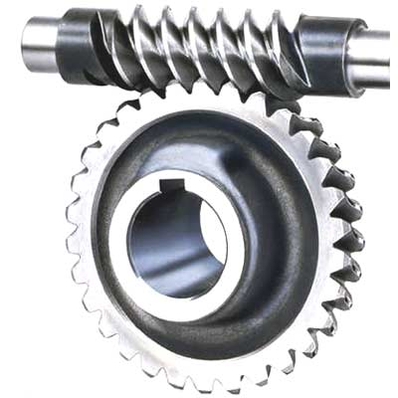
Worm Gears
Defining angles are pressure angle φ and helix angle λ
Additionally, worm and pinion surfaces are always sliding
Friction becomes an important factor
Worm gears are not 100% efficient

Slide 19
Force Analysis—Worm Gears
Directions are relative to the worm
Efficiency

